Slide 1
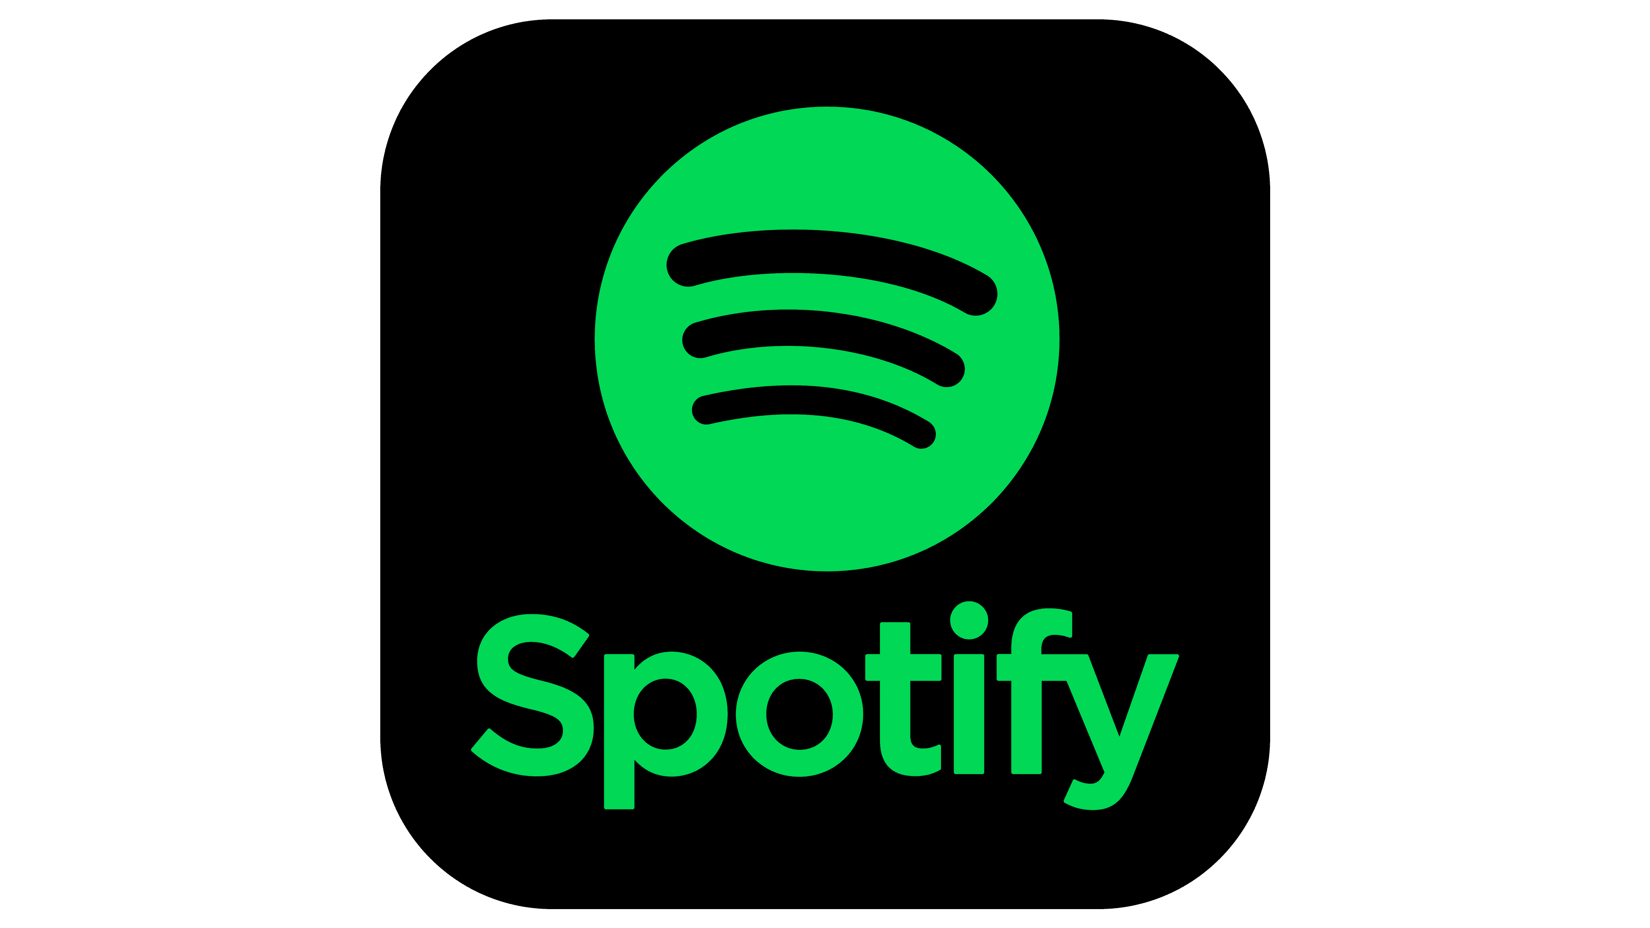
Dataset source: https://www.kaggle.com/Spotify-2023 updated: 17/12/2023
SPOTIFY ANALYSIS
- Thomas Moses - Data Analyst
PowerBI Project

Slide 2
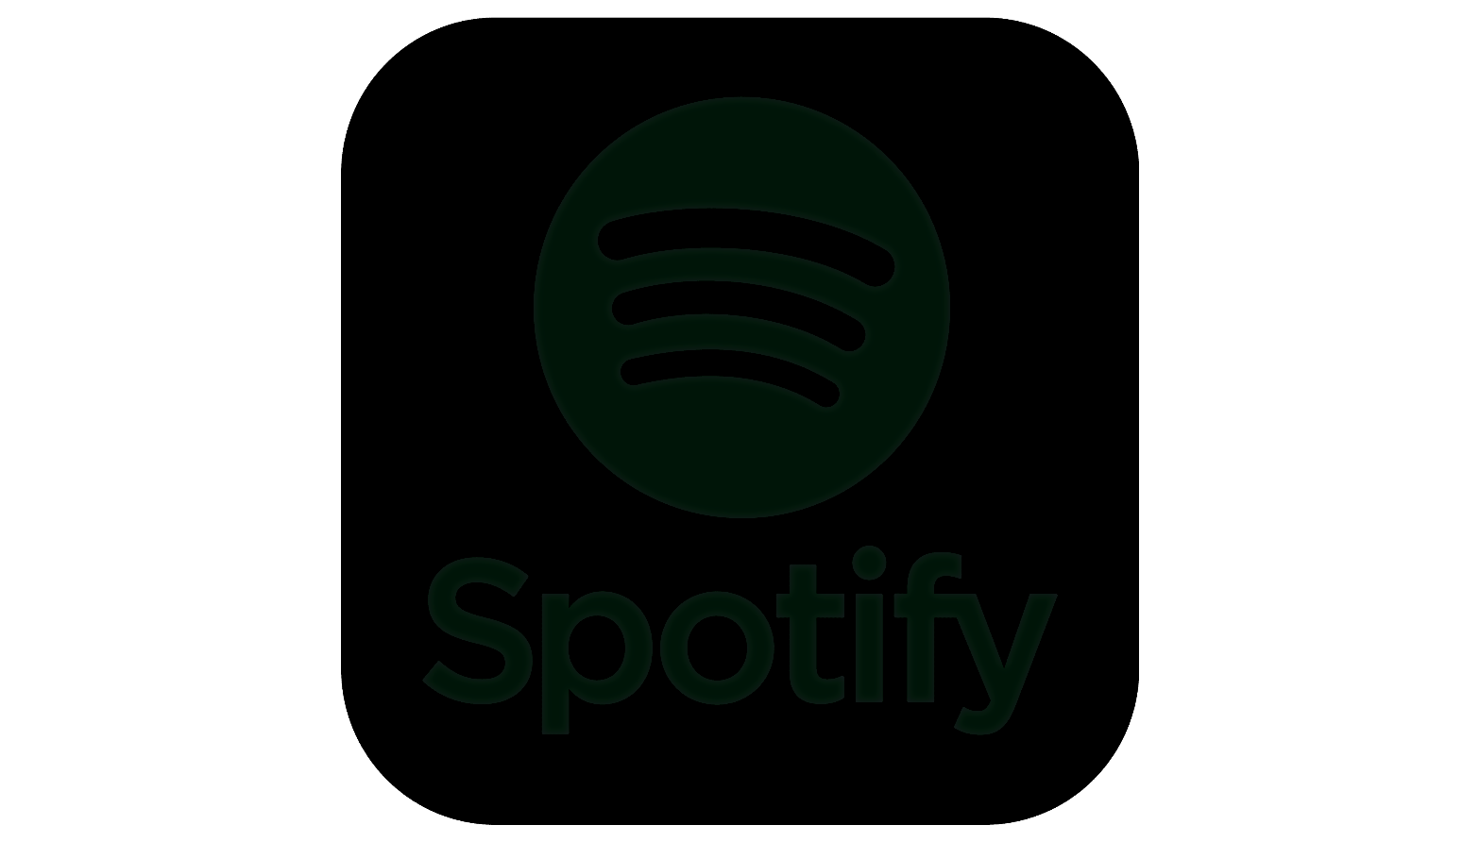
Dataset source: https://www.kaggle.com/Spotify-2023 updated: 17/12/2023
INTRODUCTION
I am excited to take you on a journey today into the world of Spotify, a music streaming service that has revolutionized the way we experience and enjoy music. Spotify, founded in 2006, has become a household name, connecting millions of users around the globe to a vast and diverse library of music. From personalized playlists to artist discovery, Spotify has reshaped the music landscape, making it an integral part of our daily lives. Join me as we explore the features, impact, and the magic behind this music streaming giant.“
From the rise of streaming platforms to the decline of physical sales, the music industry has undergone seismic shifts. Your task is to untangle the web of influences that have shaped the songs we've been grooving to over these years.

Slide 3
Dataset source: https://www.kaggle.com/Spotify-2023 updated: 17/12/2023
ABOUT THE DATASET
Our dataset contains musical information, song features, artist details, when and how every song by an artist performs in a certain year. It's a snapshot of the diverse world of music streaming, offering us a backstage pass to understand trends, discover patterns, and decode what makes our favorite tunes tick. Join me as we navigate the beats and bytes of the Spotify dataset, unlocking insights that harmonize with the pulse of millions of music lovers worldwide."

Slide 4
Dataset source: https://www.kaggle.com/Spotify-2023 updated: 17/12/2023
PROBLEM STATEMENT
Given the vast and intricate dataset encompassing Spotify's music library, user interactions, and artist performances over the past twelve years, we seek to extract meaningful insights and trends that shed light on the evolving landscape of music consumption and production. Our primary objectives include:
Top songs based on popularity
Most streamed song and Artist.
Top songs for each year since Spotify started.
Importance of Energy, Danceability, Loudness, Speechiness and Acousticness on Songs.

Slide 5
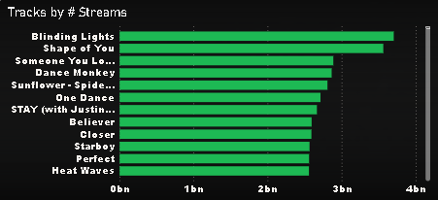
Dataset source: https://www.kaggle.com/Spotify-2023 updated: 17/12/2023
INSIGHTS
From our clustered bar chart, we are able to see the performance of each track by all time total number of streams. Blinding lights has the all-time highest streams follow by shape of you and others follow. Blinding lights has been on the top since 2020.

Slide 6
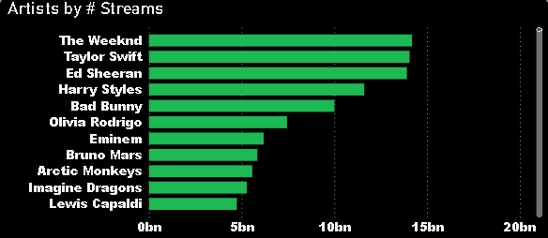
Dataset source: https://www.kaggle.com/Spotify-2023 updated: 17/12/2023
INSIGHTS
Our clustered bar charts shows us the top most streamed all-time artist on Spotify. The weekend with their song “Blinding lights” tops the chart. Taylor swift follows and Ed Sheeran comes third then other artists.

Slide 7
Dataset source: https://www.kaggle.com/Spotify-2023 updated: 17/12/2023
RECOMMENDATIONS
When I was looking for data to work on for this PowerBI project, I stumbled upon this Spotify data first and I thought “yes everyone likes music” so I decided to try it out.
My recommendations would have been to artists only but I can see I have three groups to speak to about this analysis.
First, Spotify needs to add more music, they need to look into African music especially the Nigerian afro type of music because from my analysis, there are very limited number of artists from Africa on Spotify. They need to create more awareness about this platform so that they can get upcoming artist to place their songs on their platform.
Secondly, to artists. As an upcoming artist, the era of selling your music through compact disk(CD) has ended and the only way you can get your music to the public and make some money is by placing them on this platforms, especially Spotify.
Lastly, we music lovers are limited to using memory cards which is less likely to exist in the next 5 years. We need to go to these platforms and stream our latest songs so we can have our own favorite artist on the top lists. It is love we are sharing and I believe the only way to show our favorites love is by streaming our favorite music through platforms like Spotify.

Slide 8
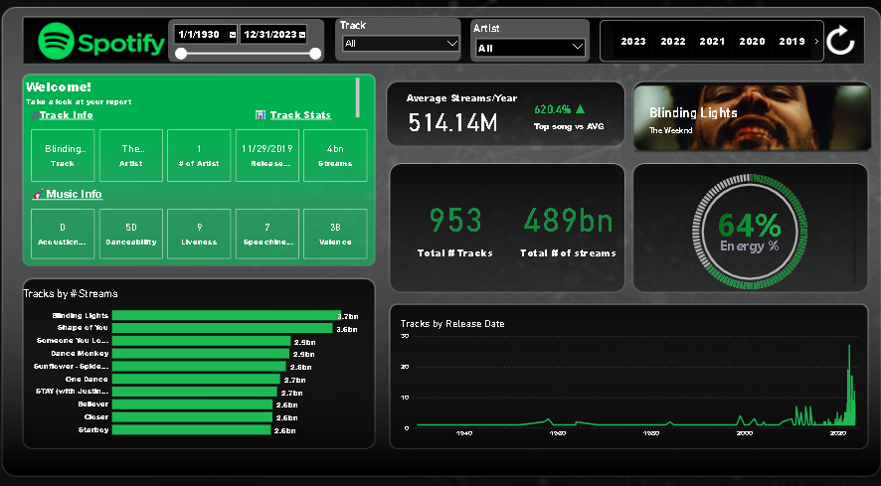
Dataset source: https://www.kaggle.com/Spotify-2023 updated: 17/12/2023

Slide 9
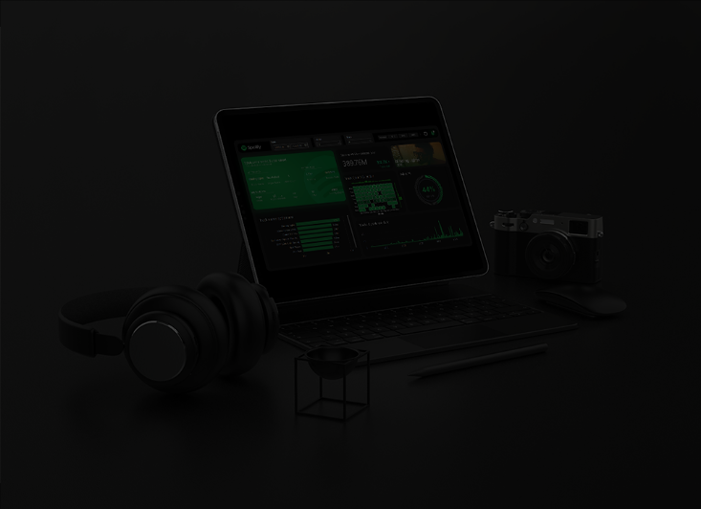
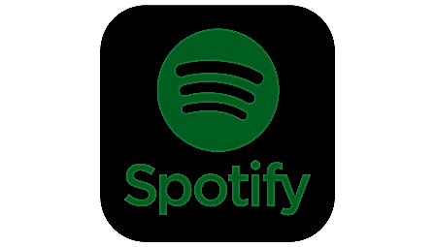
Dataset source: https://www.kaggle.com/Spotify-2023 updated: 17/12/2023
THANK YOU

